Slide 1

Baystate Banner Voting Patterns
Group members:
Abdullah Albijadi, Audrey McMillion, Gordon Ng, Ji Zhang, Thachathum Amornkasemwong
CS506

Slide 2

Content
Background
Results
Challenges & Limitations

Slide 3
Part ONE
Background
Why are we doing this project? What are the motivations?

Slide 4
Project Description
What do the clients want to know?
Terminology
Description
Methods
Ward
Precincts
Preliminary or Primary election
General election
Districts
In this project, we are trying to understand how racial voting patterns in Boston changed over the past decade on the Ward Precinct level. The components to measure voting behavior include ballots cast, blanks cast, registration, eligible voters, and turnout along with census data.
Data Processing
Data visualization

Slide 5
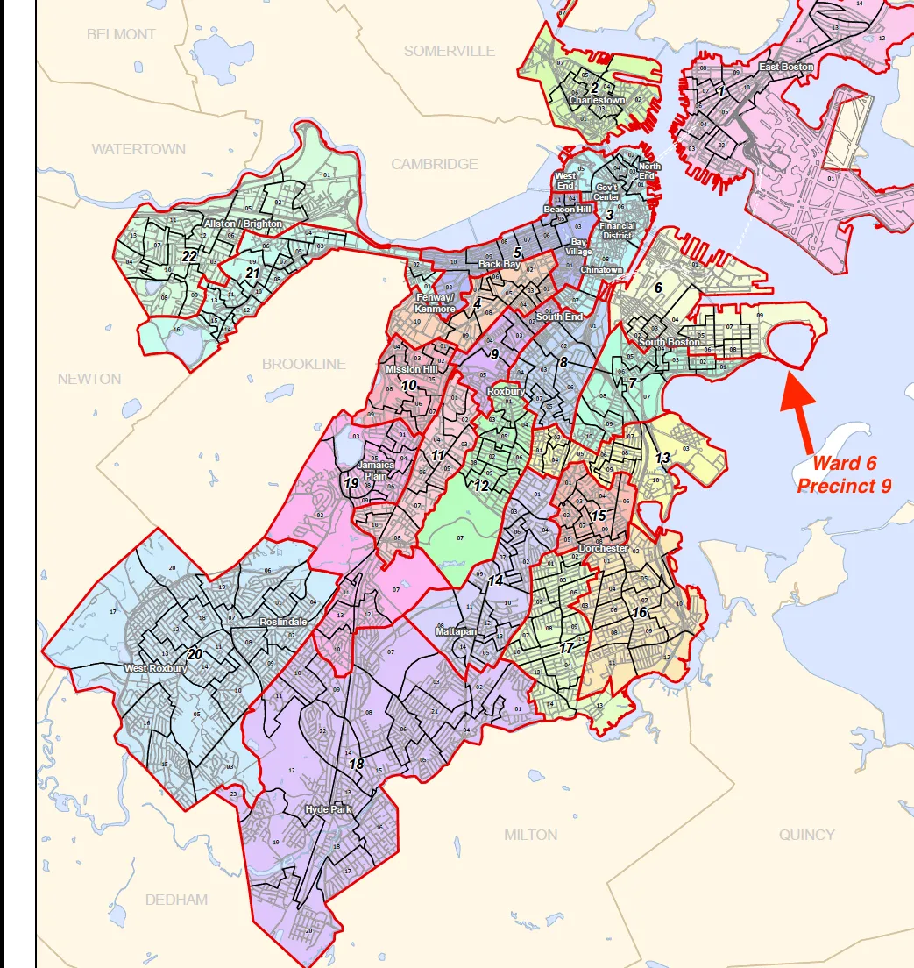
Boston Wards and Precincts
A Map of Boston Wards and Precincts

Slide 6
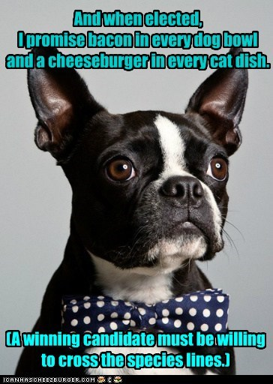
Election Types
Elections types and years in Boston
Presidential: 2016 & 2020
District Attorney: 2019
Mayoral: 2017
House: 2018
Senate: 2020
City Council: 2011, 2013, 2015, 2017, 2019
pic: https://cheezburger.com/5636221184/he-has-my-vote

Slide 7
Key Demographics
Key races?
White
Asian
Black
Hispanic
Notes:
亮亮图文旗舰店https://liangliangtuwen.tmall.com

Slide 8
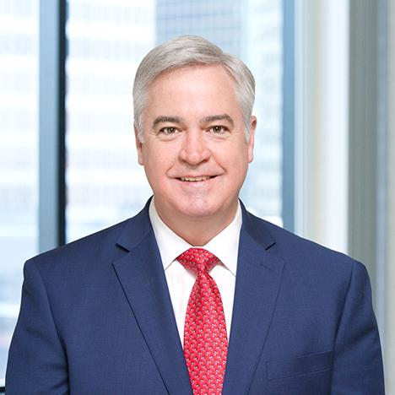
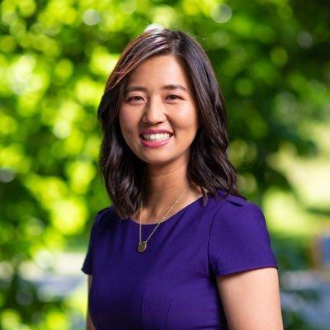
Key City Council Candidates
People you must know!
Micheal F. Flaherty
Michelle Wu
The only white City Council candidate.
The first Asian City Council candidate.

Slide 9
Key Questions
What questions are we trying to solve?
How has voter turnout by precinct changed across city council election year?
What are the key predictors in determining support for Black candidates for Boston?
How do racial voting patterns differ by election type?
How have the demographic changes in Boston affected local elections over the past decade?
What are changes in District 3 particularly?

Slide 10
Part TWO
Results
What have we found? And why do our results matter?

Slide 11

Overarching Project Question
Are there any overarching racial voting patterns in Boston on the Ward-Precinct level?
And how does this vary across election type over the past decade?
We have found a variety of racial voting patterns on the Ward-Precinct level in Boston across election type during the past decade.
Most of the answers to this question are incorporated into our key questions that we explore in our next slides.

Slide 12
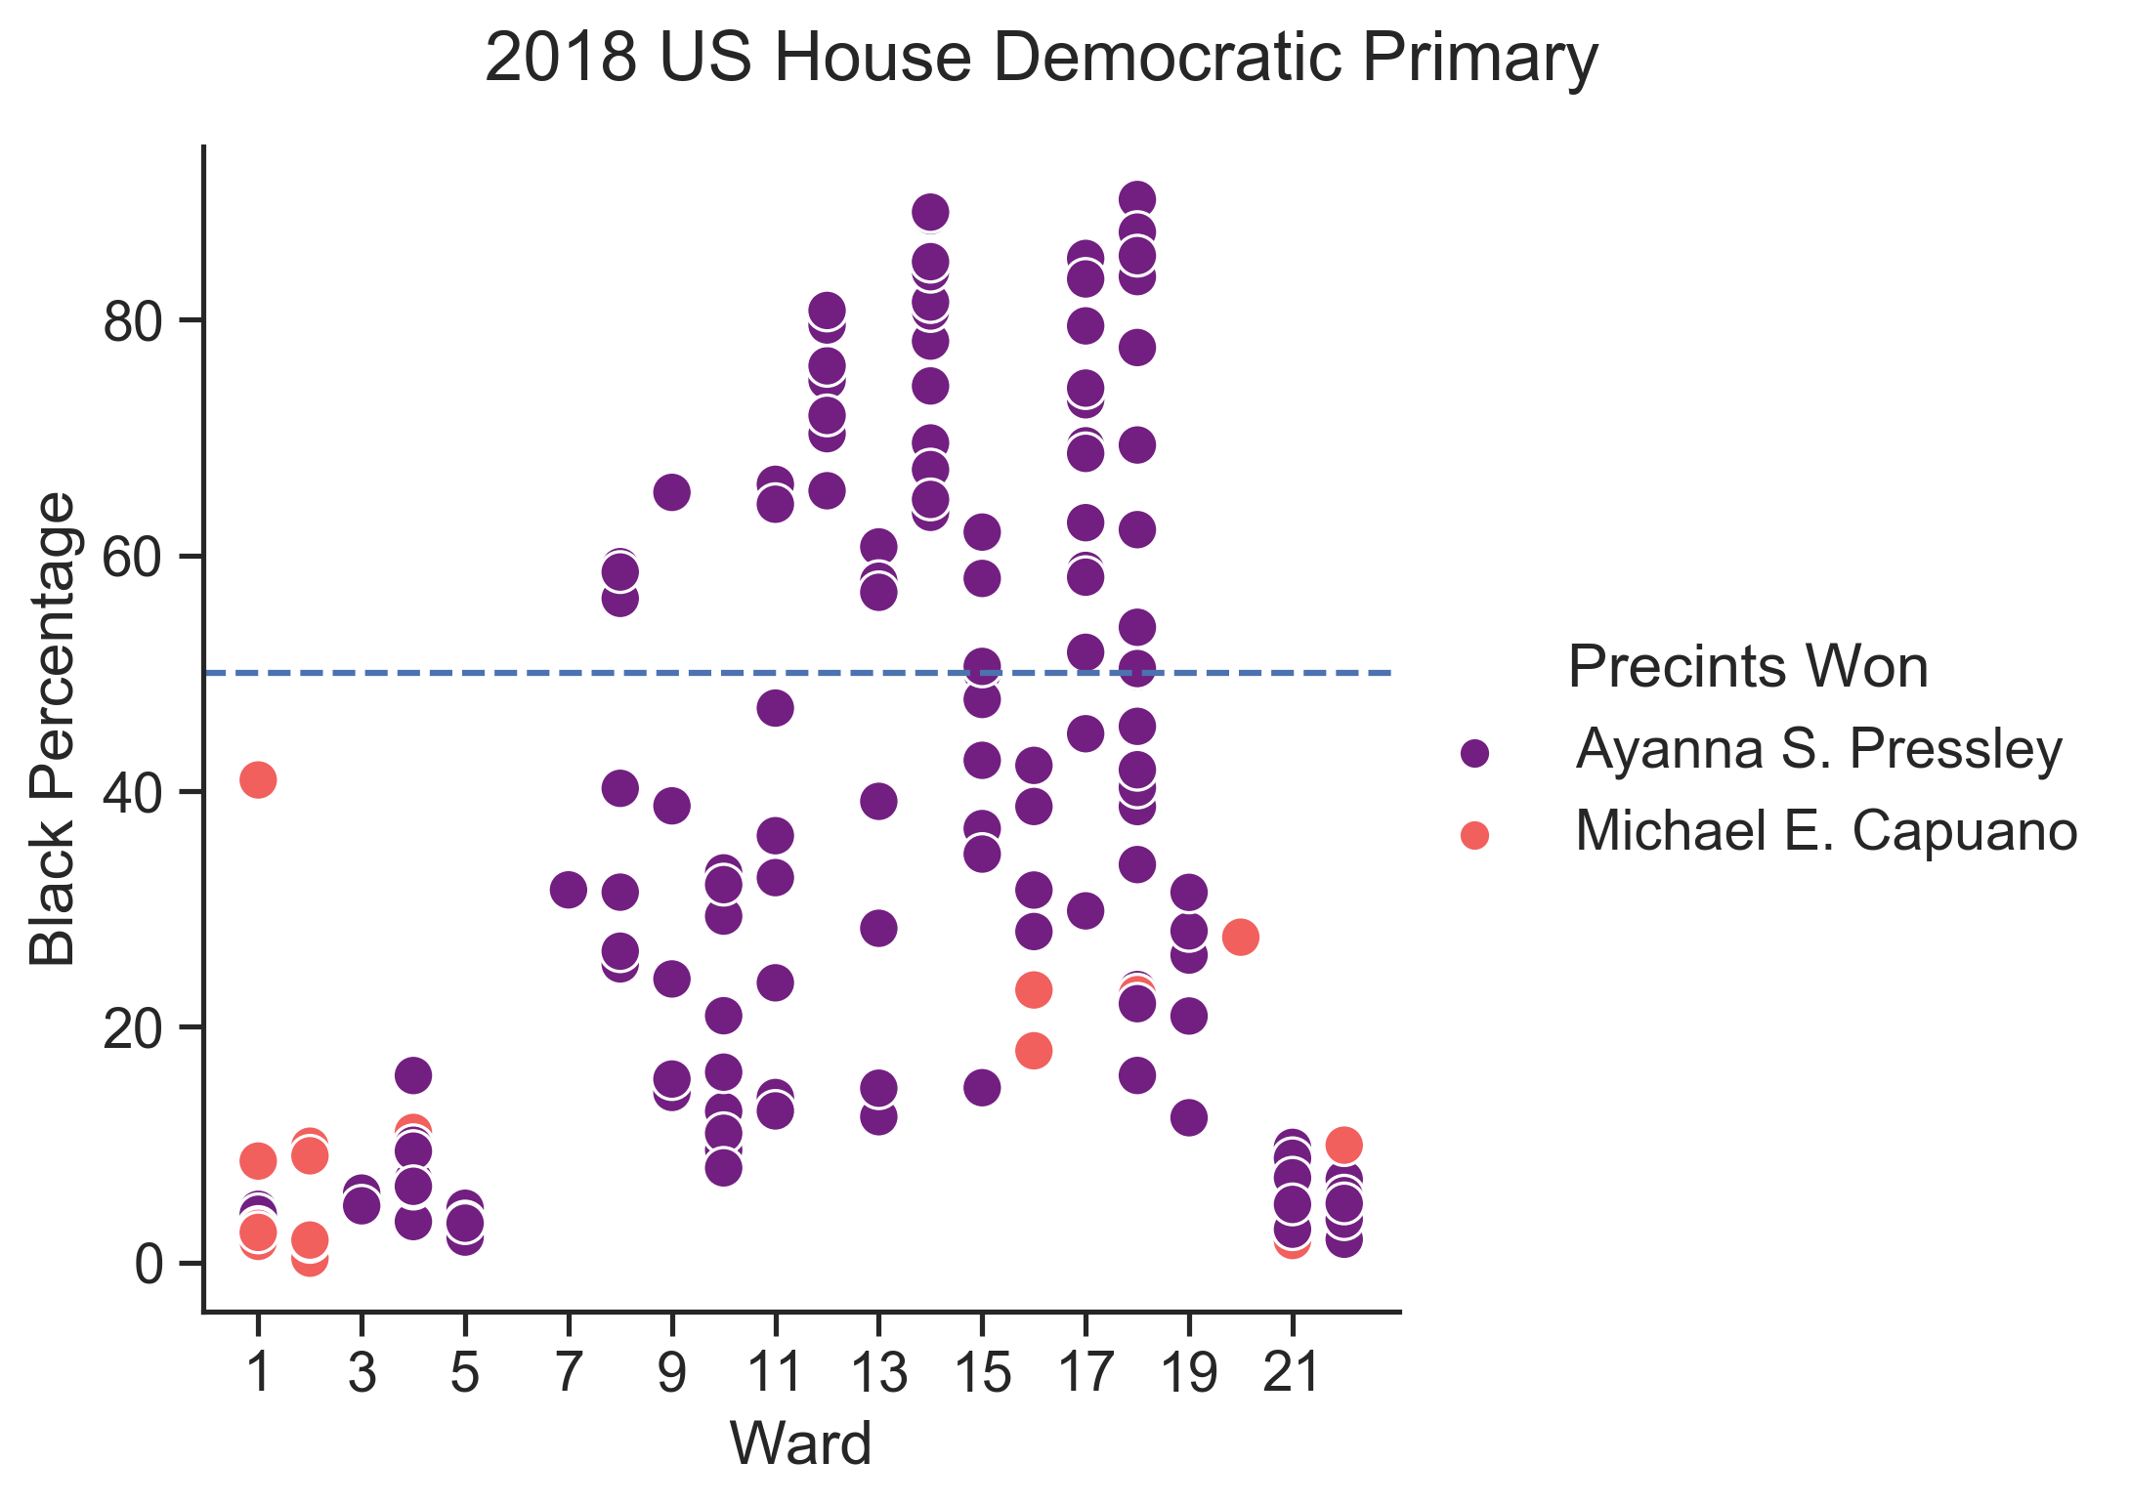
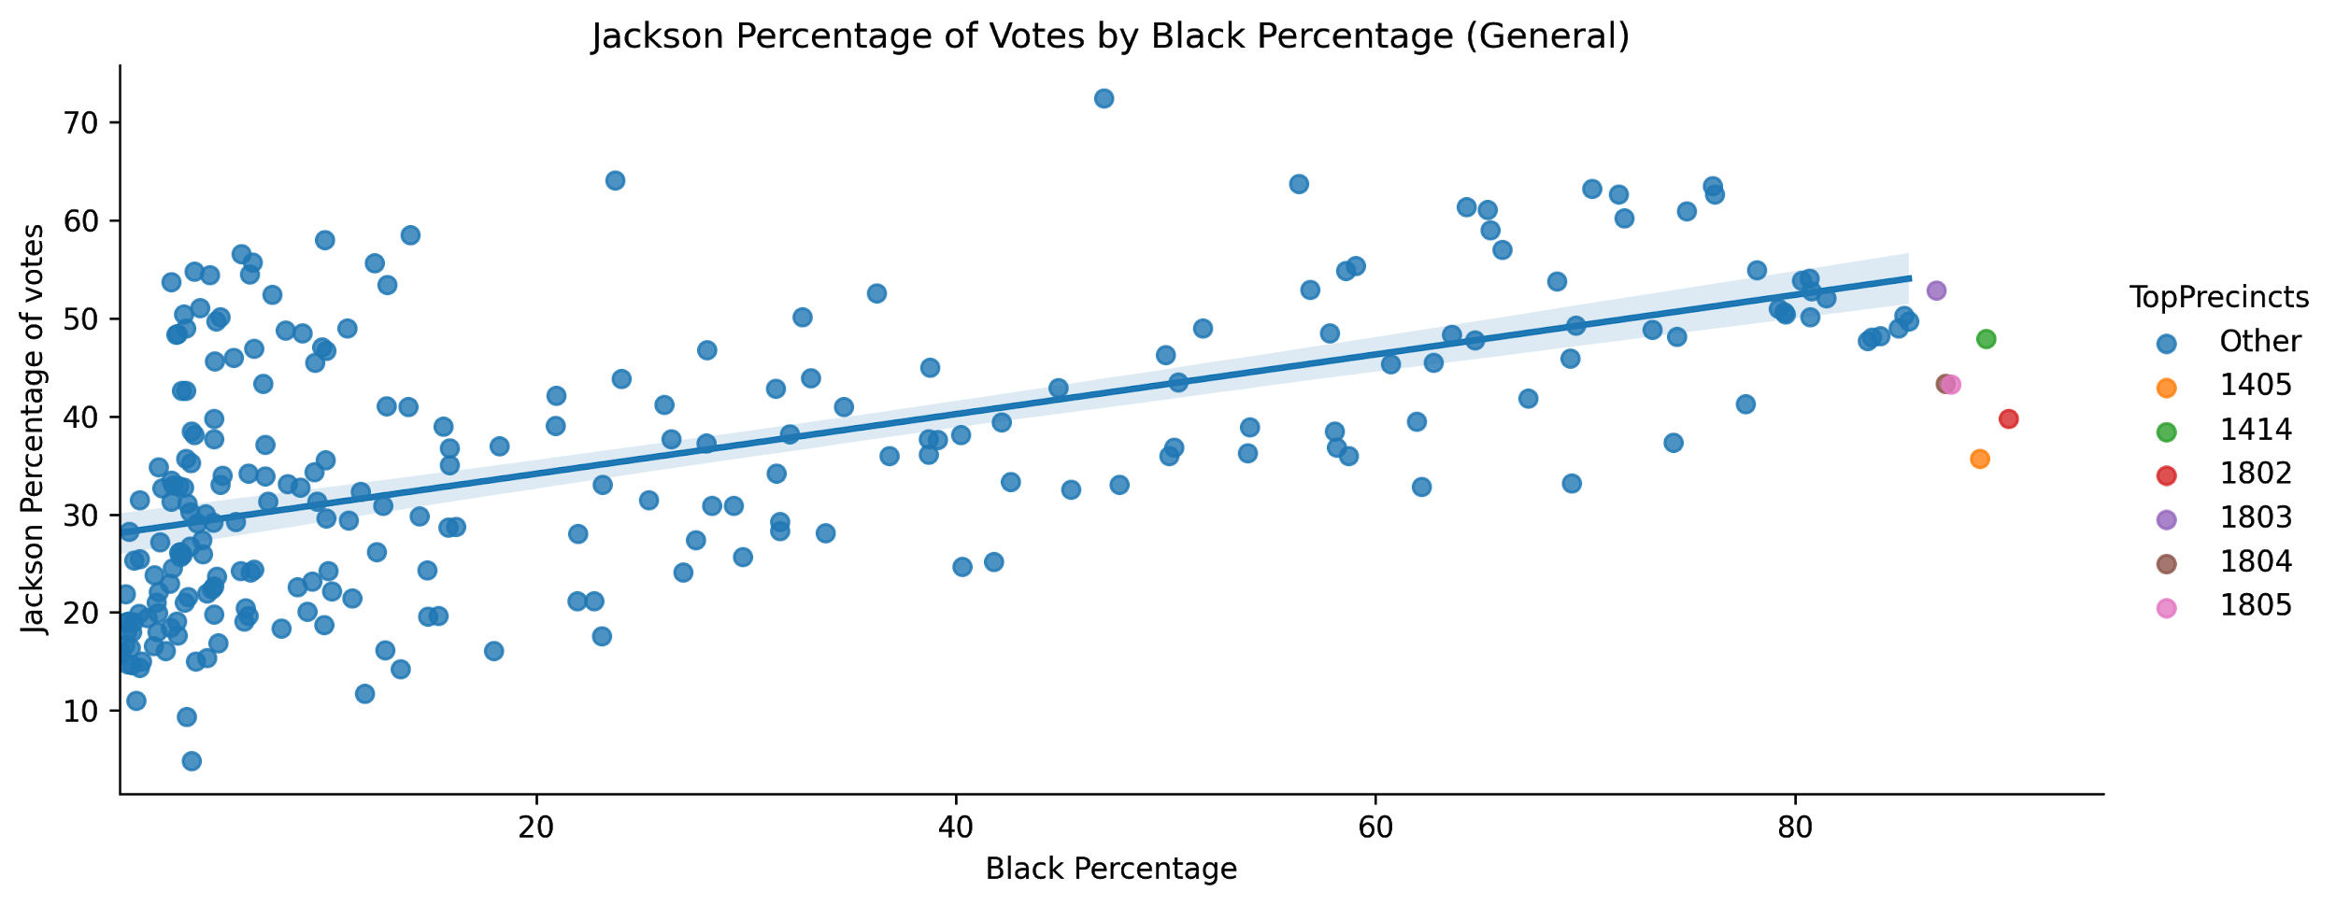
How do racial voting patterns differ by election type?
Black candidates tend to receive support from precincts with high Black populations.
1
Turnout for city council elections which coincide mayoral elections is generally much higher than turnout for stand-alone city council elections.
2
For certain elections, such as the 2018 U.S. House Democratic primary, the race of the candidate does not seem to be a primary factor in determining whether or not the candidate will win a specific precinct.
3

Slide 13
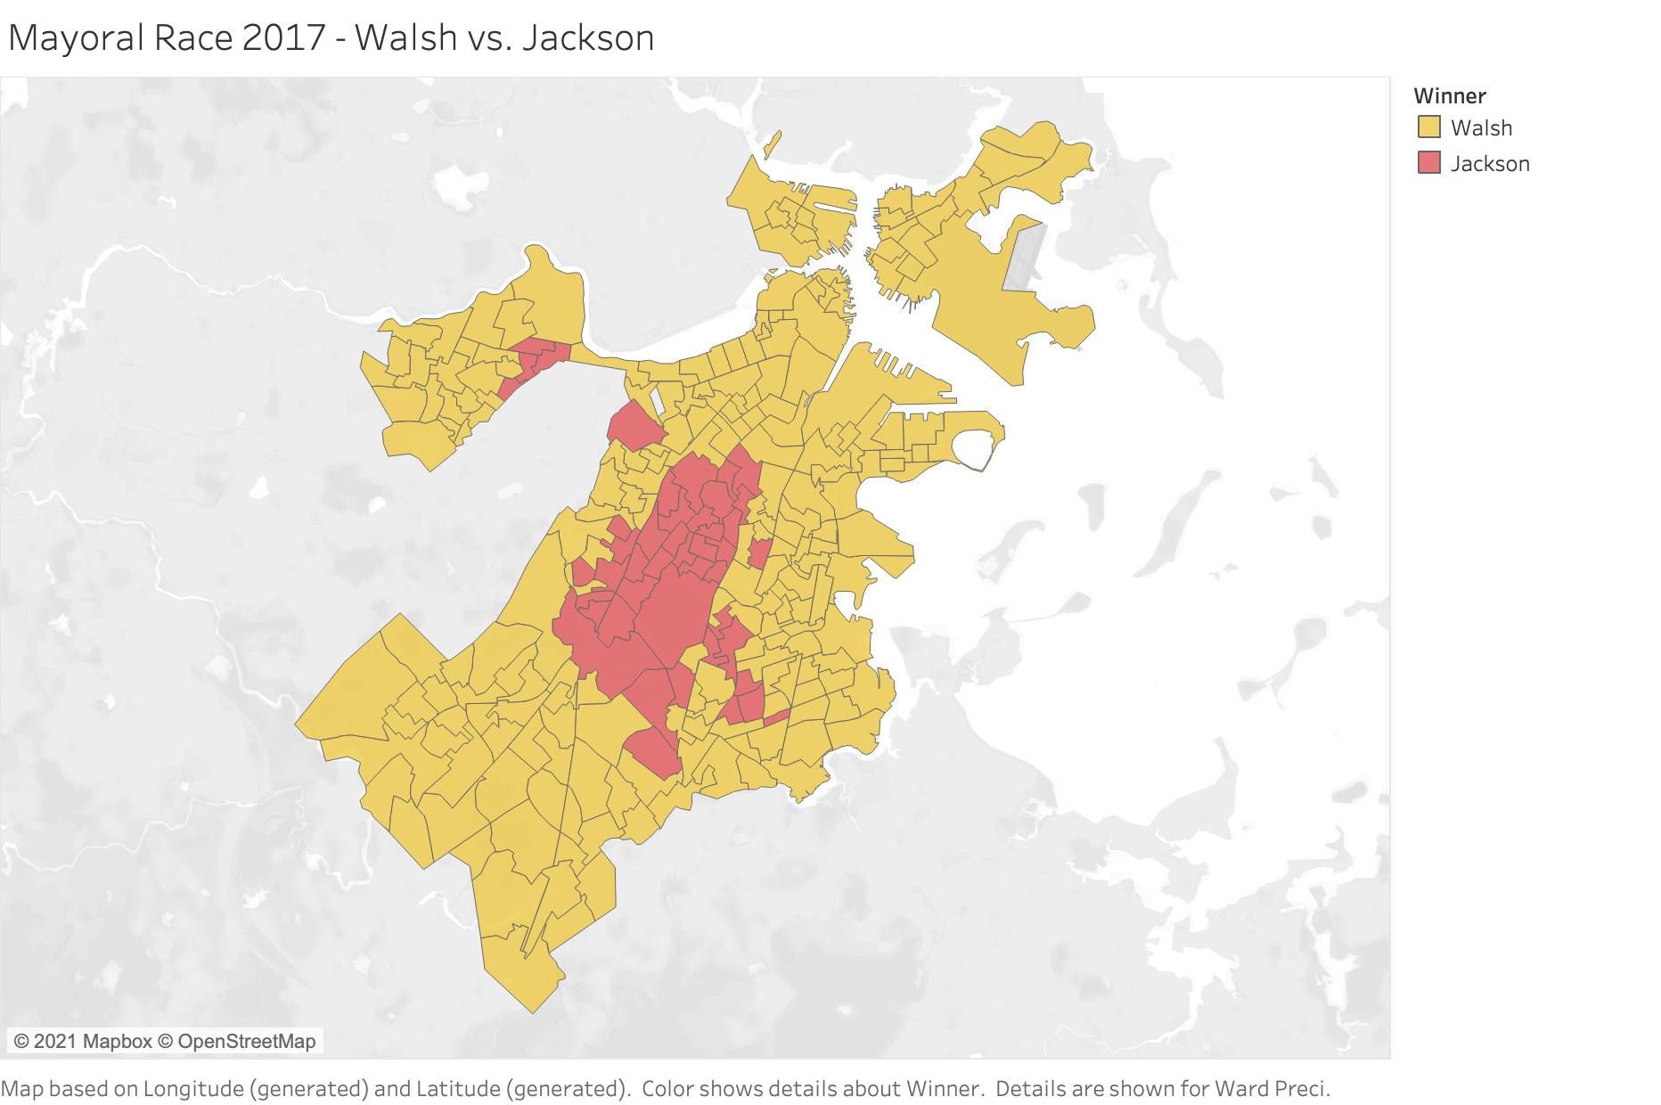
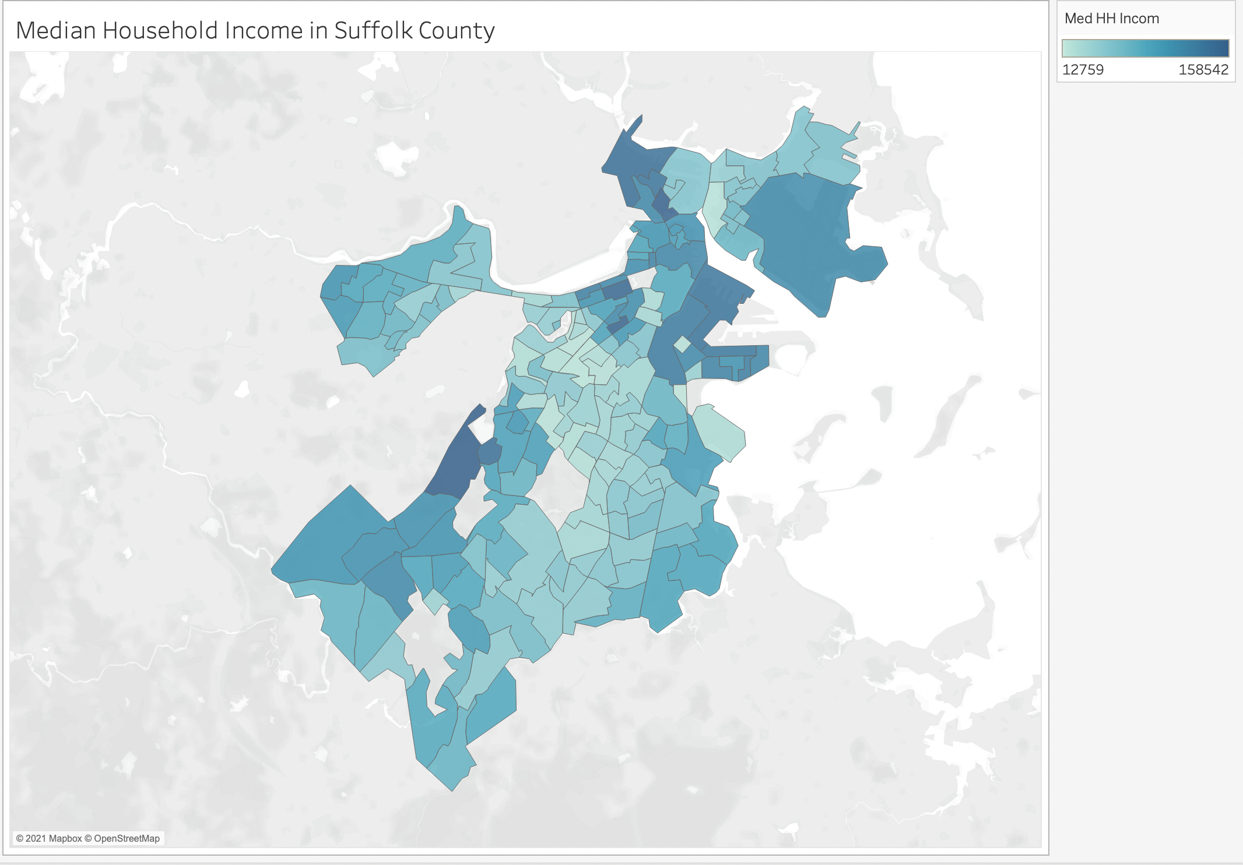
What are the key predictors in determining support for Black candidates for Boston?
There is a strong positive correlation between the percentage of votes Black candidates receive and the higher the Black population in a specific precinct.
1
There seems to be a slight correlation between certain Black candidates (Tito Jackson and DA Rollins) winning a given precinct and that precinct’s median income and average educational attainment.
2

Slide 14
How has voter turnout by precinct changed across city council election year?
Precincts which have the most volatile voter turnout are concentrated in East Boston and West Roxbury and are either majority Hispanic or majority white.
a
b
Precincts which have experienced the greatest change in share of voter turnout are more dispersed ethnically, and are concentrated in areas of Dorchester and Downtown Boston.
c
Flaherty’s share of voters decreased in precincts with high white populations.
d
Michelle Wu’s greatest change in share of voter turnout occurred in precincts with high white populations.
e
For precincts with a majority Black population, there has been a consistent improvement in voter turnout for City Council Elections.

Slide 15
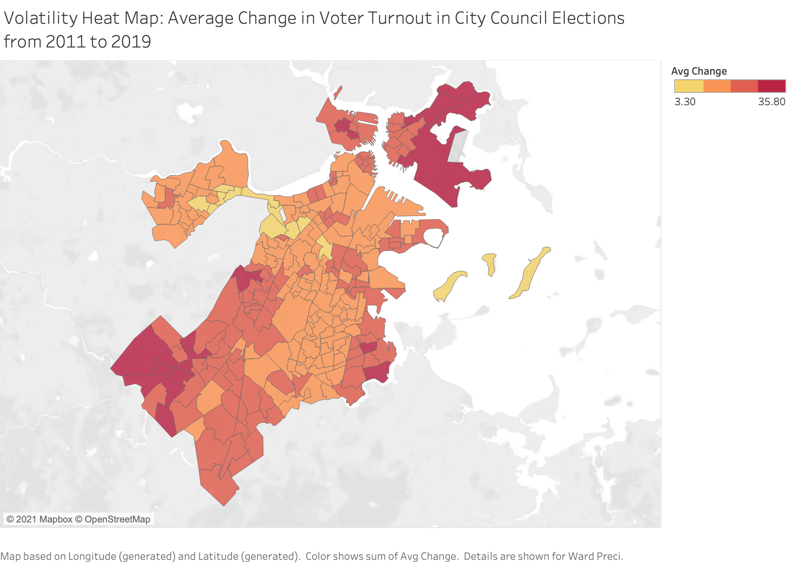
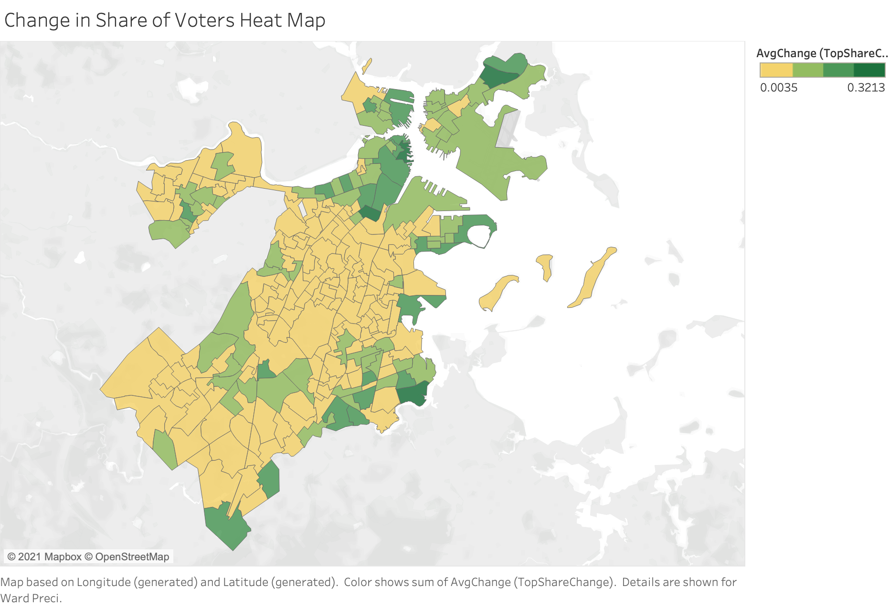
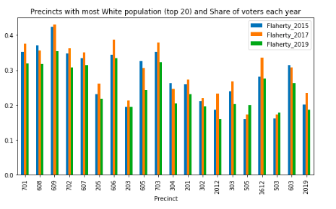
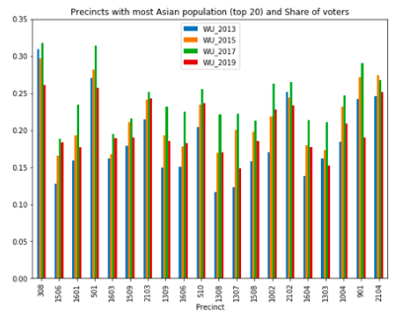
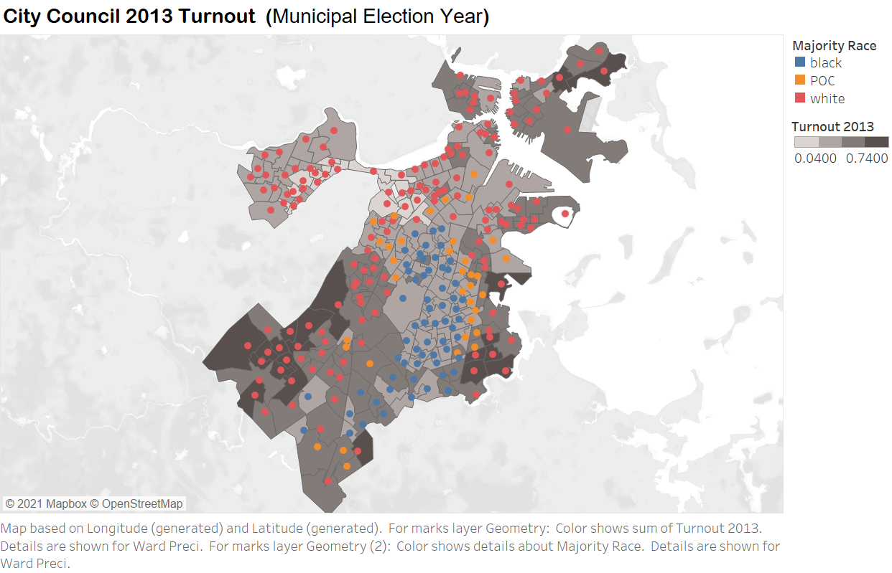
Key Charts from our City Council Analysis

Slide 16
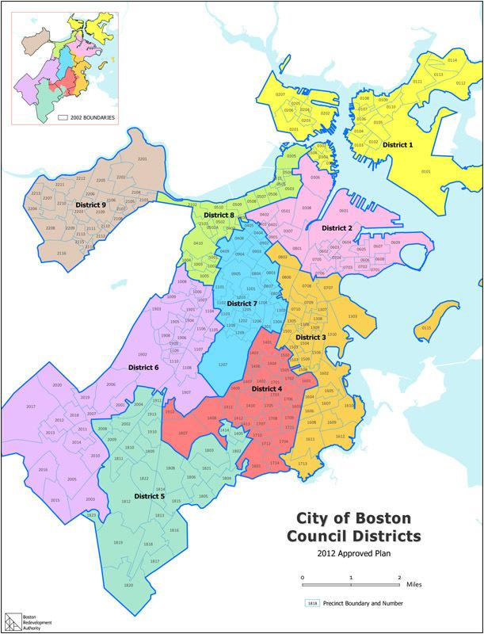
What are changes in District 3 particularly?
Those precincts which experience the greatest volatility and change in share of voter turnout across City Council election year tend to be concentrated in the southern part of District 3. Additionally, these precincts tend to either be ethnically varied or have a very low POC population.
The trends in Michael F. Flaherty’s voter turnout for District 3 is the same as the general pattern. Precincts which have experienced the greatest change in share of Michael F. Flaherty’s voter turnout do not have a strong correlation with a single race population.
The trends in Michelle Wu’s voter turnout for District 3 follow the same general pattern as Boston overall.
Overall, the southern precincts in District 3 tend to have much higher turnouts than southern areas. And recently, precincts with high Black populations have seen higher turnout than earlier ones.

Slide 17
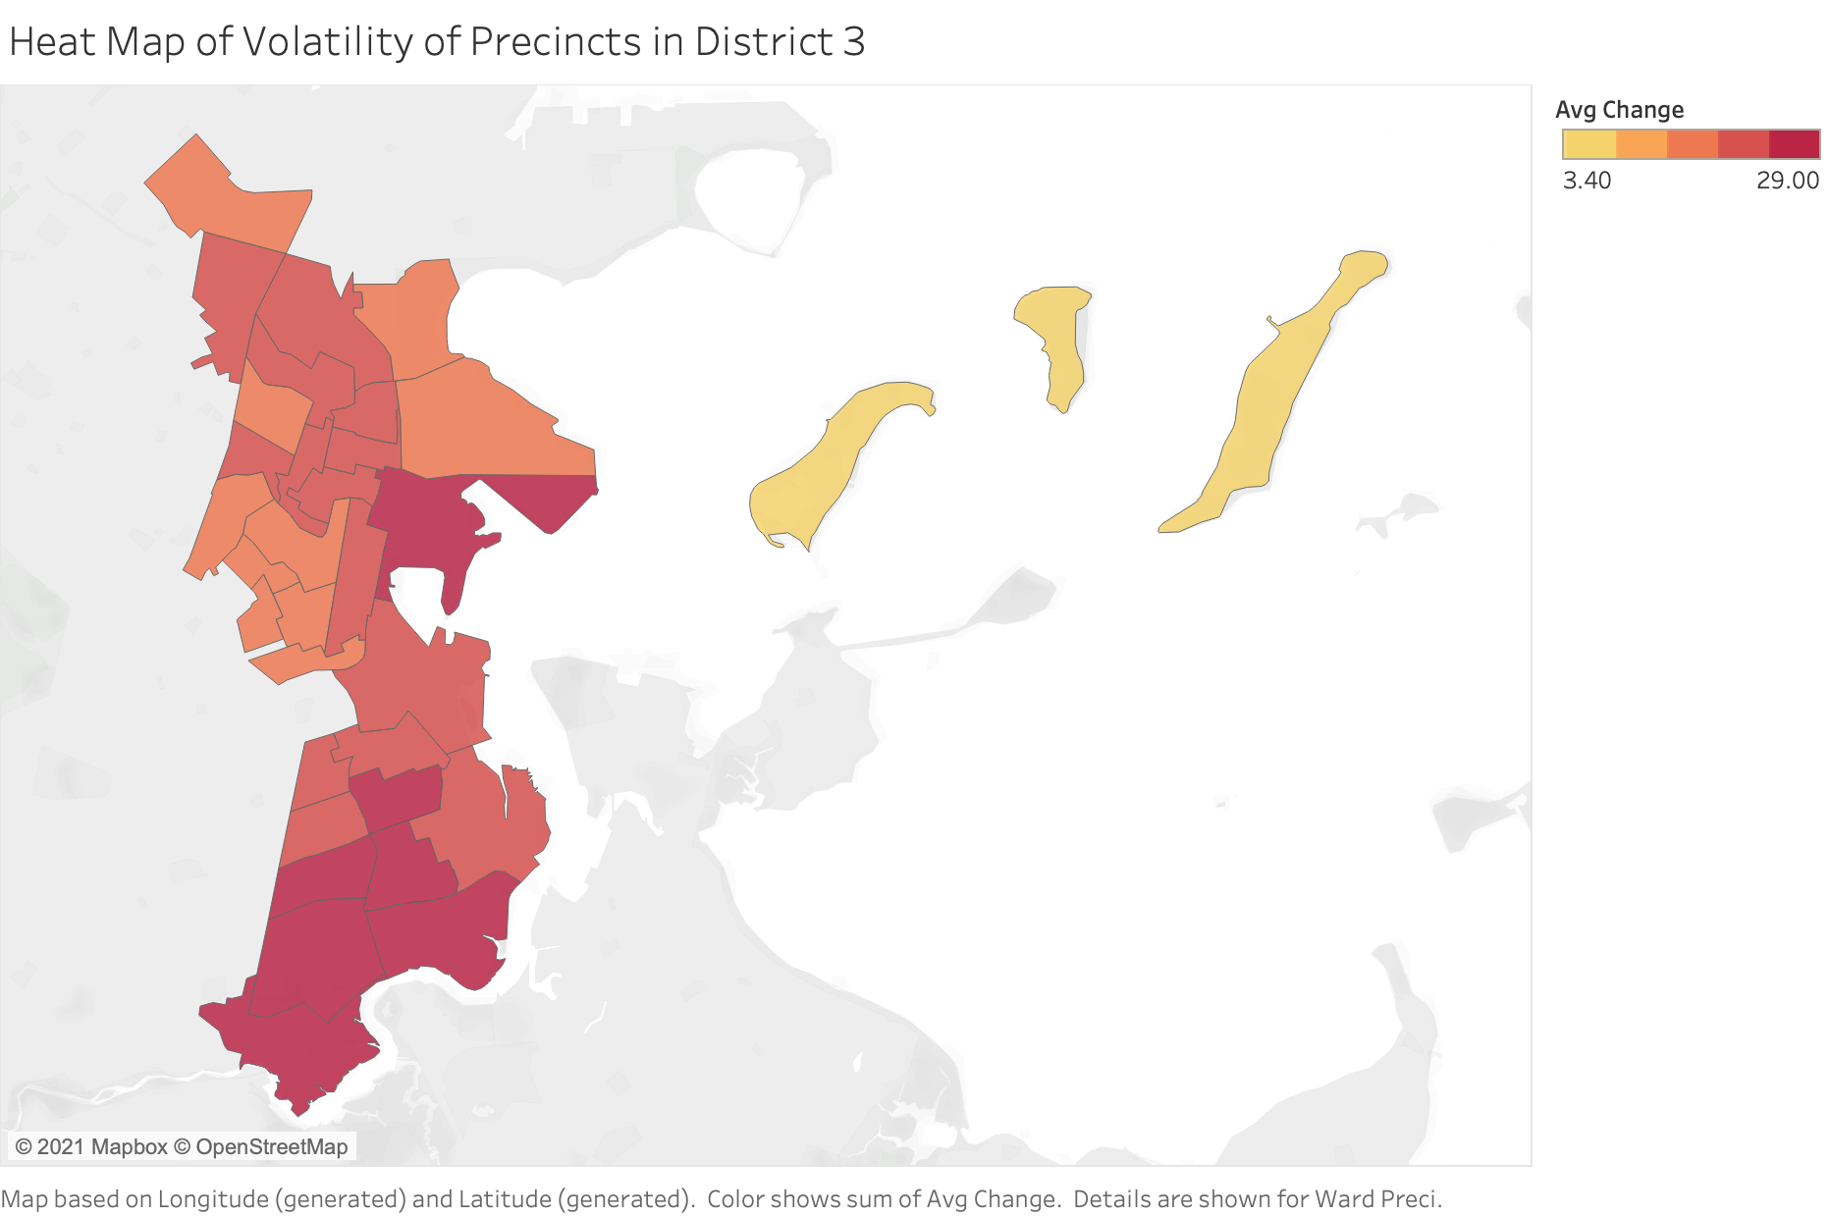
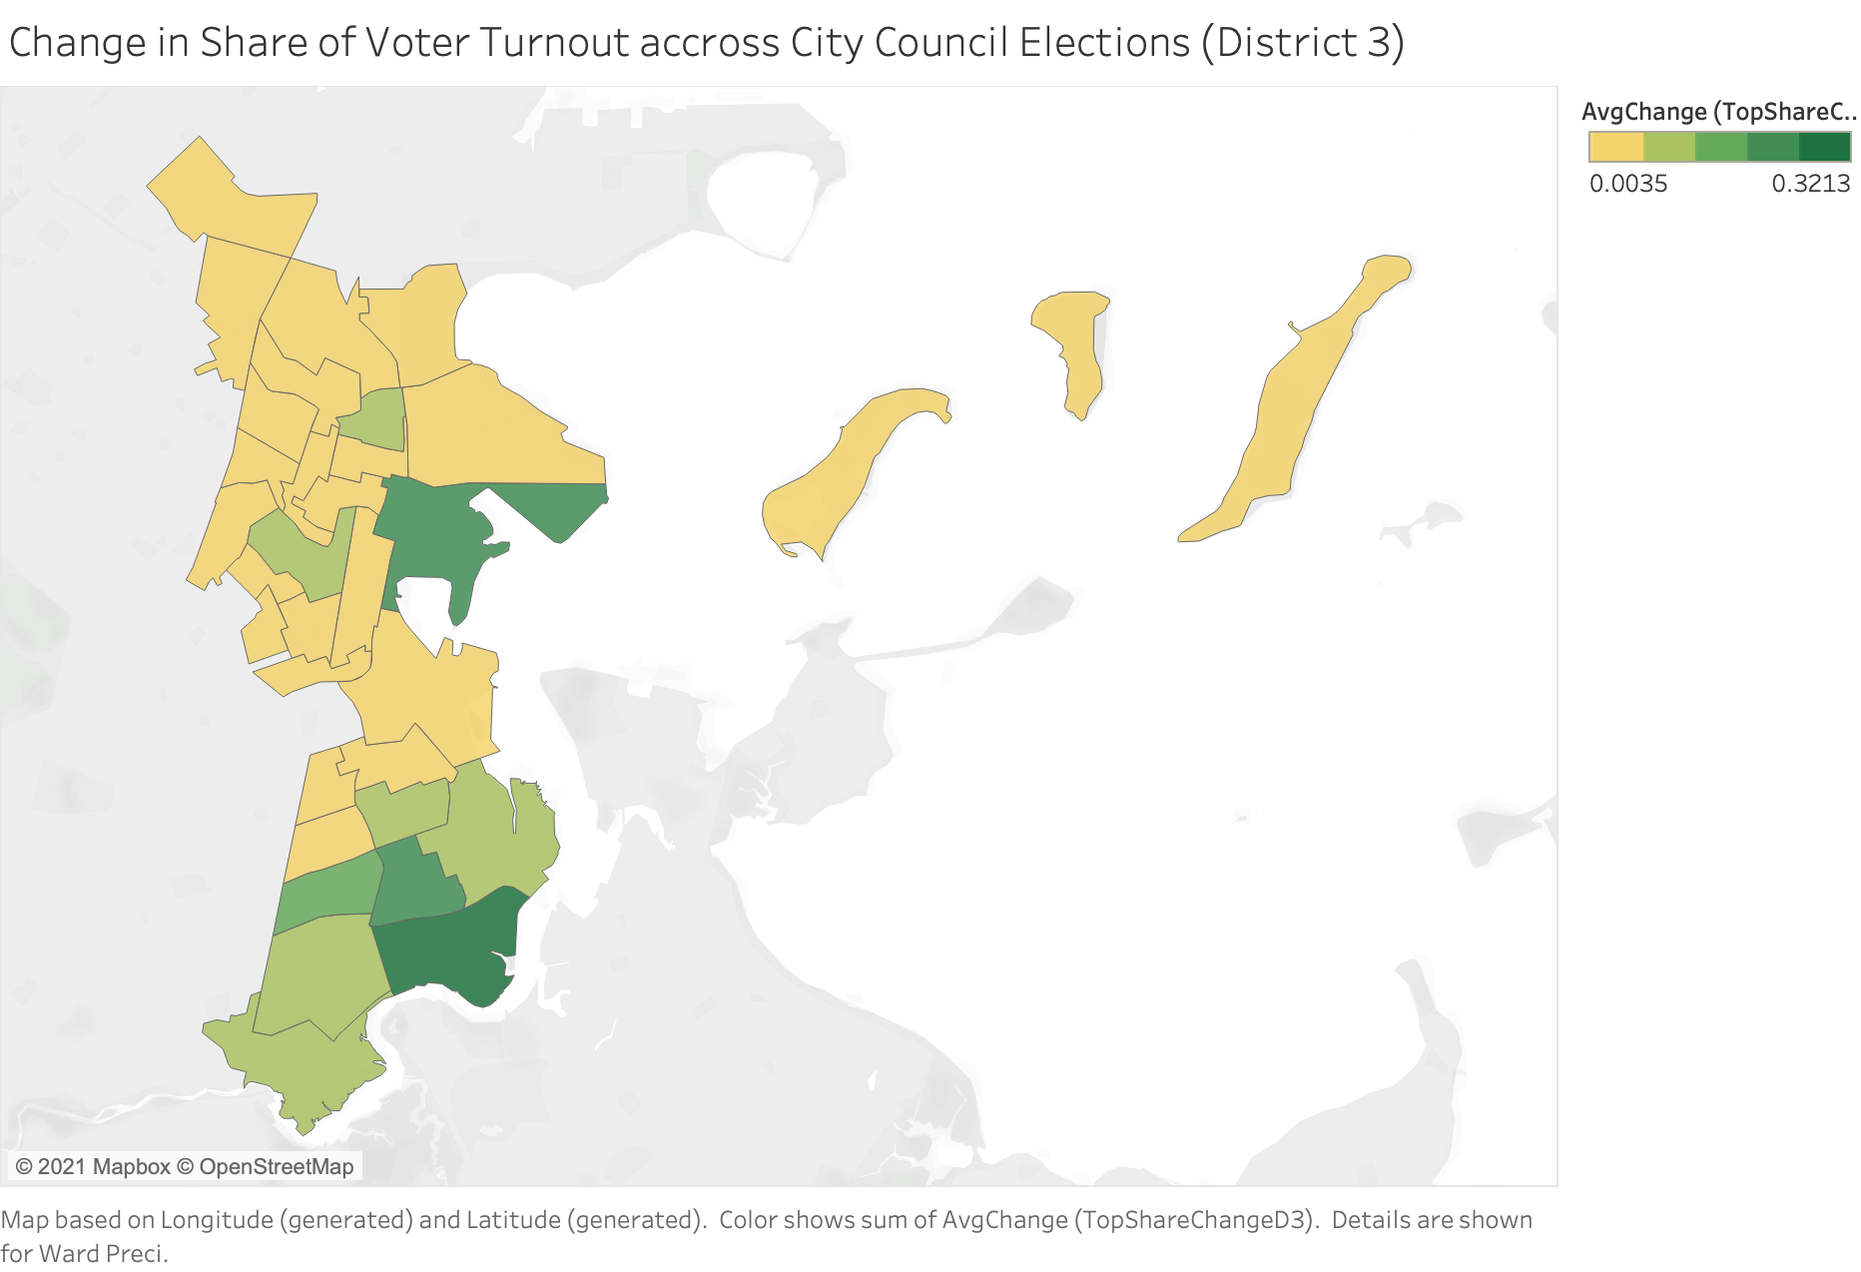
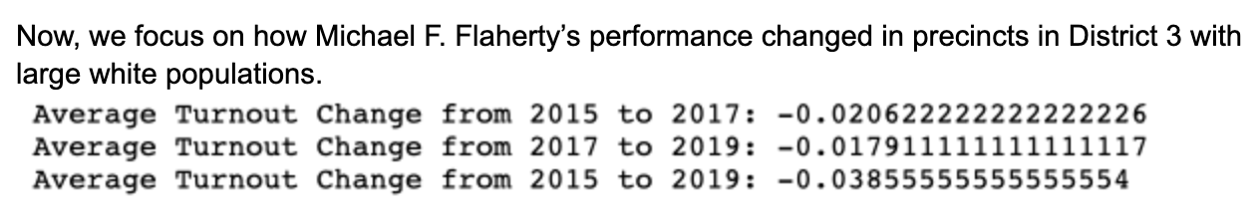
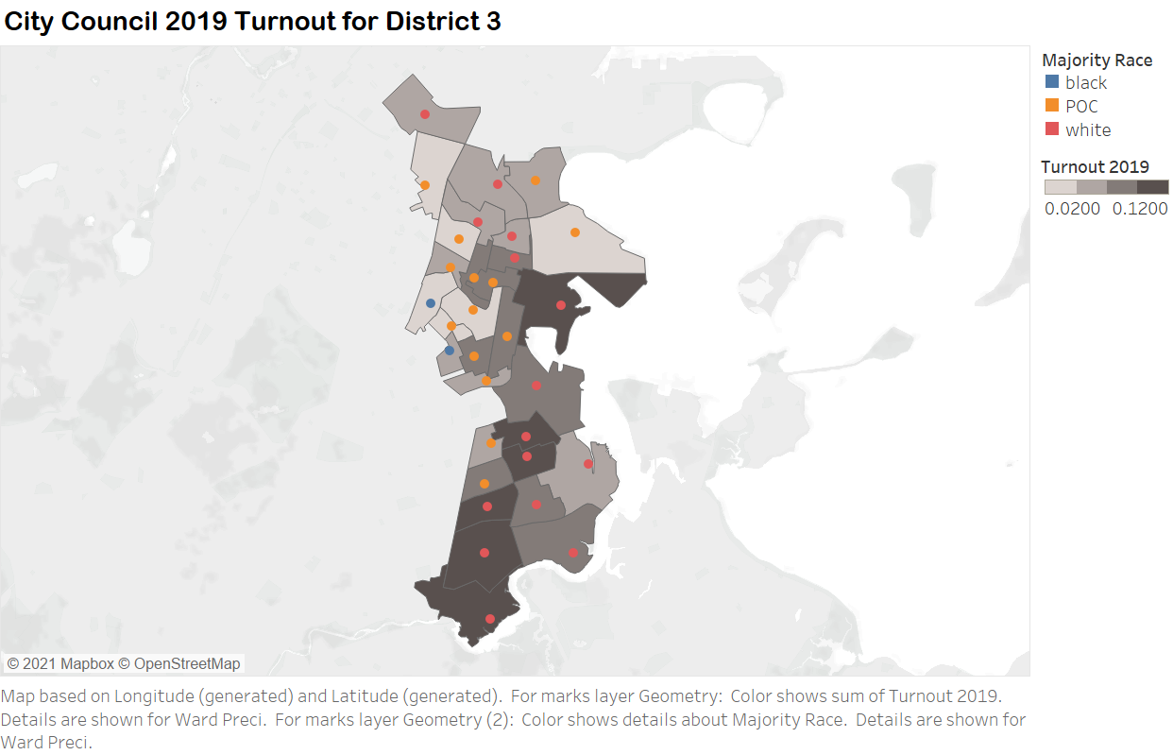
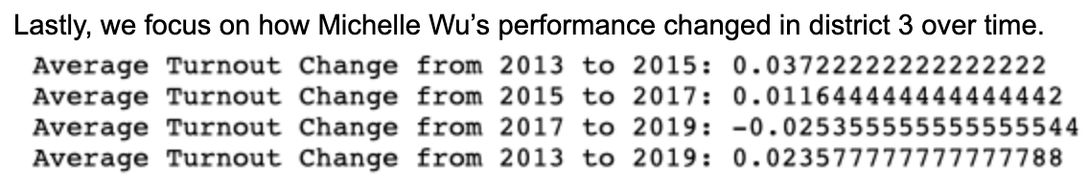

Slide 18
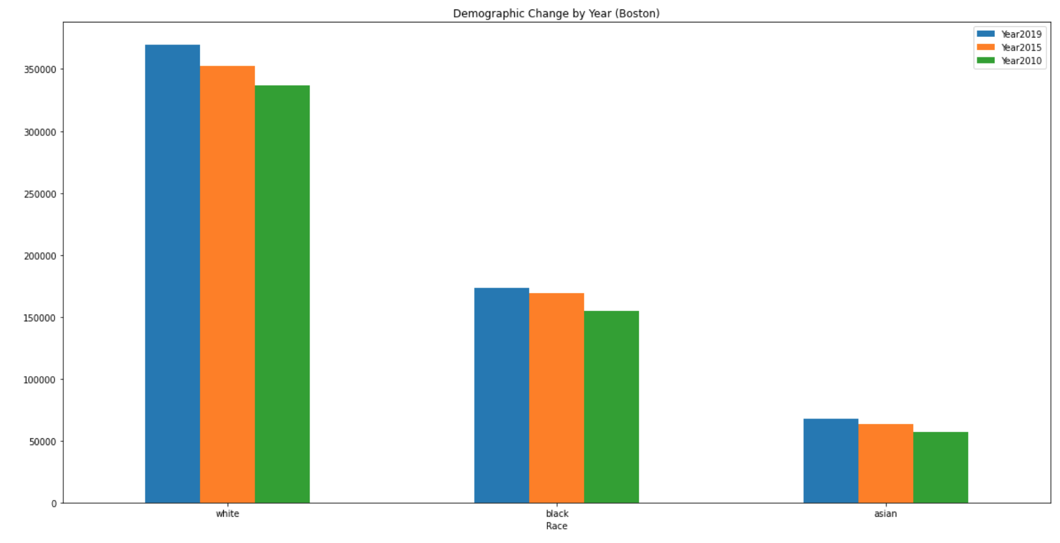
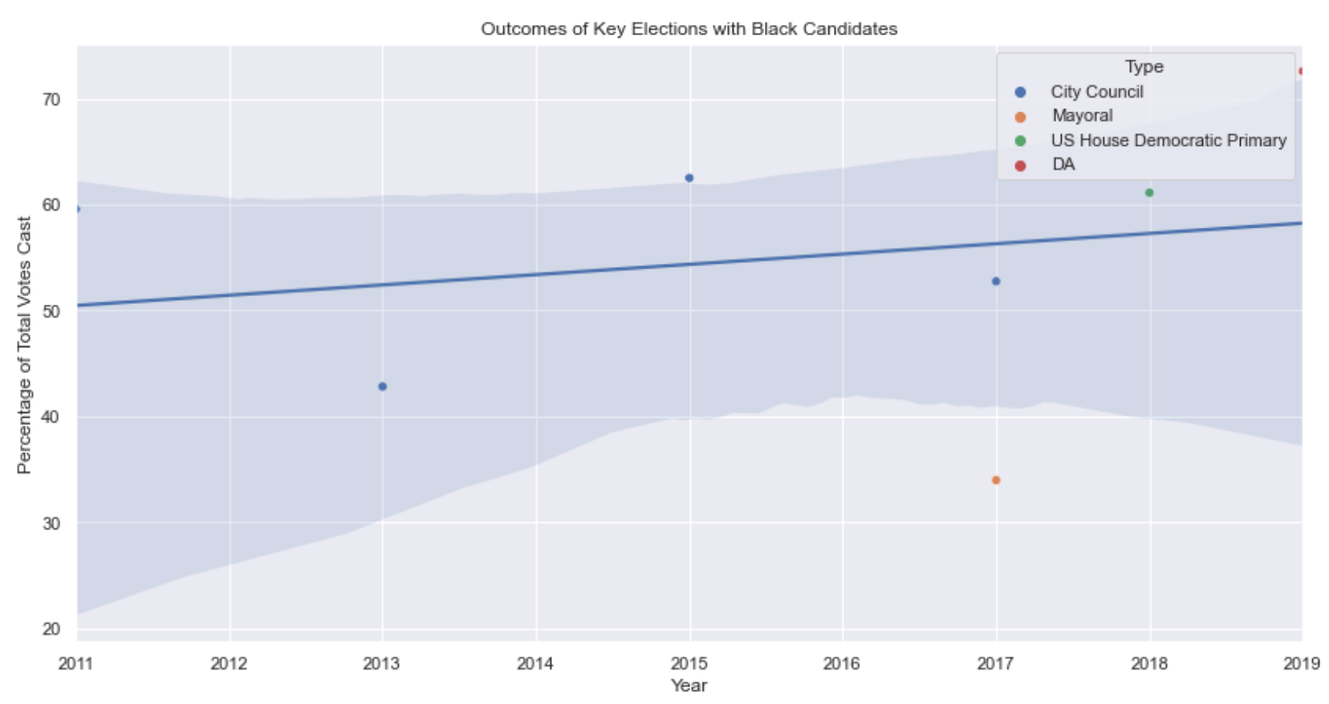
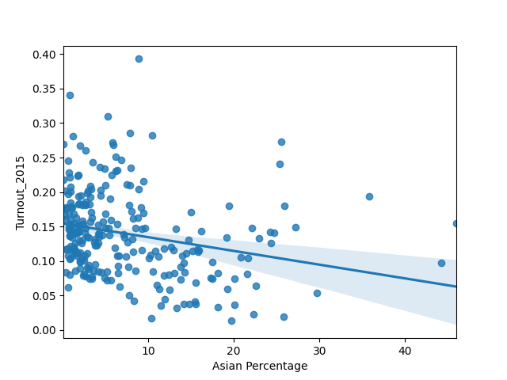
How have the demographic changes in Boston affected local elections over the past decade?
Over the past decade, we found that Black, White, and Asian populations in Boston have steadily grown in numbers.
In examining the performance of Black candidates in key Boston elections, we found that, over the past decade, there has been a slight upward trend in their performance. This coincides with the growing Black population, however, causation cannot be determined.
Over the City Council years, we were unable to find any significant correlation between precincts with high Black, Hispanic, and White populations and high voter turnouts. However, we did find that for CC years 2011-2017, there was a negative correlation between precincts with high Asian populations and voter turnout, but this changed in CC election year 2019. This coincides with the growing Asian population in Boston, however, causation cannot be determined.

Slide 19
Part THREE
Challenges & Limitations
What could we do better? Future work?

Slide 20
Challenges
What challenges we have? Are they solved?
Inaccessible
Data
Spark team helped with some datasets.
Pulled data on Government websites, downloaded, cleaned, and adjoined with Census data.
Incomplete Data
Outdated census data
Concrete census data only available from 2010, used American Community Survey for year-by-year estimates.

Slide 21
Limitations
Analysis
Finding Data
Short Period
Most of our work focused on the City Council Elections since we had multiple over the past decade.
We had hoped to find certain datasets, but this data was unavailable online.
Analysis was done over 1 decade and also only contains some elections of that decade.

Slide 22
Next Steps
Incorporate final comments from the client.
Finalize the final report.
Publish our analysis in the Bay State Banner or Dorcester News newspaper.

Slide 23
Thank You!

